Slide 1
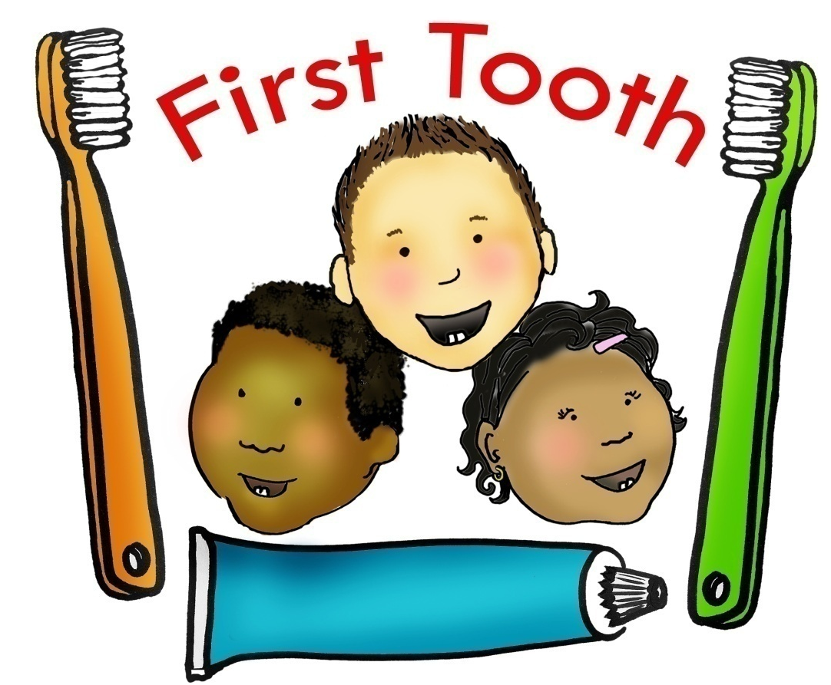
Preventing early childhood caries through medical and dental provider education and collaboration

Slide 2
Current Status of Children’s Oral Health in Oregon
Compared to the 2002 Oregon Smile Survey, in 2007₁:
38% increase in number of children with decay in their permanent teeth
49% increase in the number of children with untreated decay
Among low-income children, half have untreated tooth decay
Only 27% Oregon communities have fluoridated water₂.
As of 2/9/11, there were 361 OHP enrollees per OHP dental provider₃.
1 www.oregon.gov/DHS/ph/oralhealth/docs/smile_2007.pdf
2 http://apps.nccd.cdc.gov/MWF/Index.asp
3 Division of Medical Assistance Programs (DMAP)

Slide 3
“First Tooth” Project Overview
In collaboration with the Oral Health Coalition’s (OROHC) Early Childhood Cavities Prevention Committee (ECCPC), launched a three-year work-force development project called “First Tooth”.
Purpose of this project is to reduce childhood tooth decay in Oregon by focusing preventive services on infants and toddlers under age three.
Project is funded by the Health Resources and Services Administration (HRSA).

Slide 4
“First Tooth” Project Goals
Expand the oral health workforce in Oregon by utilizing medical care providers to deliver early childhood caries prevention services to at-risk children ages birth to three years.
Develop and launch an online training and resource center.
Facilitate collaborative referral relationships between dentists and primary medical care providers so that Oregon children have a dental home.

Slide 5
The Role of the Pediatric Provider
Assess
Screen
Educate
Intervene
Refer

Slide 6
“First Tooth” Curriculum
Adapted from the Washington Dental Service Foundation.
Training modules include:
Prevalence & Impact of Oral Disease
Risk Assessment
Oral Health Education & Anticipatory Guidance
Implementation & Workflow

Slide 7
Oral Health Education & Anticipatory Guidance
Training topics include:
Motivational interviewing
Diet & feeding
Oral hygiene
Oral health during pregnancy
Caries process & transmission

Slide 8
Provider Toolkit
Each practice, site or clinic that completes the First Tooth training is eligible to receive one free toolkit.
Supporting materials include:
Fluoride varnish instruction & starter applications
Baby & toddler toothbrushes
Parent/caregiver education & materials
Provider pocket guide
Oral health flip chart
Implementation & workflow tips
Billing procedures

Slide 9
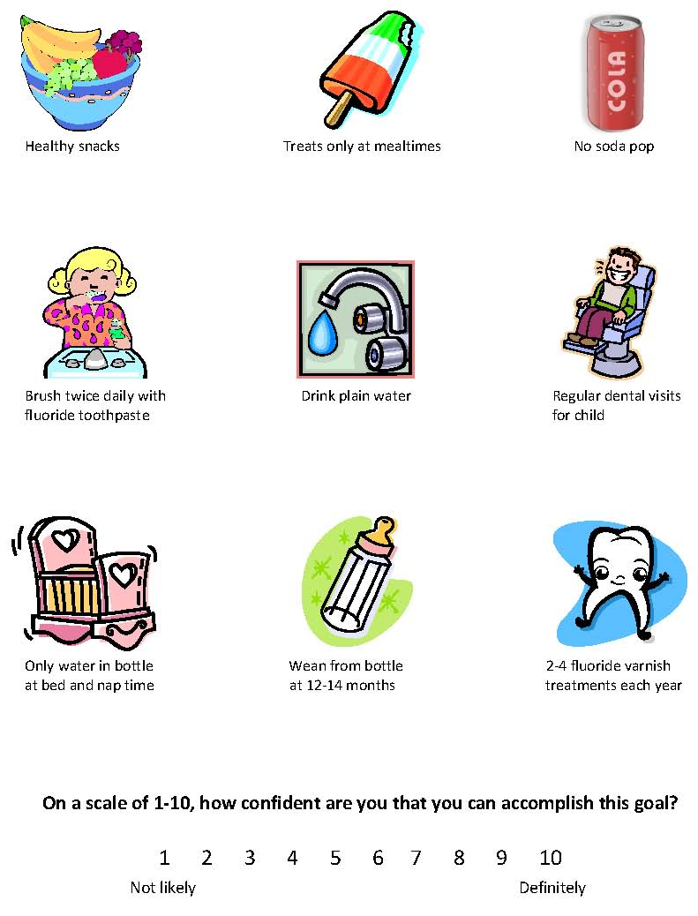
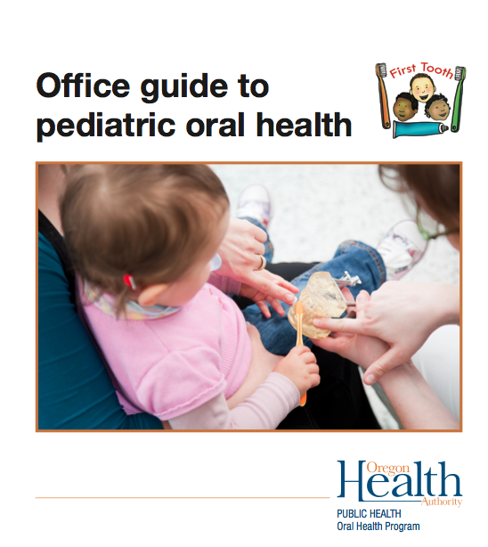
Example of Provider Tools

Slide 10
Educational Posters
Notes:
10

Slide 11
In-Person Training
In-office CME/CE 1 - 2 hours.
Includes all providers and staff.
Hands-on demonstration and practice of fluoride varnish application.
Guidelines given to help the provider refer children to a dental home by age one.
Continued support and technical assistance with implementation, workflow, and clinical instruction.

Slide 12
Training Statistics
34 in-person trainings have occurred as of 9/15/11:
19 medical & 15 dental
503 participants have been trained:
254 medical providers
249 dental providers
Trainings have occurred in 12 counties:
Clackamas
Deschutes
Douglas
Jackson
Josephine
Lane
Lincoln
Morrow
Multnomah
Tillamook
Washington
Yamhill

Slide 13
Training Feedback

Slide 14
Web-Based Training
Online CME/CE 1 - 1.5 hours.
Separate trainings for medical and dental providers.
Interactive:
Downloadable resources
Links to websites
Expanded definitions
Evaluation questions are asked throughout the training.
Eligible to receive one free provider toolkit.
First Tooth website will have resources and materials available to download.

Slide 15
Web-Based Training Demo

Slide 16
What’s Next
Expand outreach and training efforts statewide.
Continue providing on-going support and technical assistance.
Launch both medical and dental web-based trainings.
Conduct outcome evaluation data collection and analysis.
Disseminate and present evaluation report and results.

Slide 17
Anticipated Outcomes
Expand the oral health workforce serving young children by utilizing pediatric medical providers to provide early childhood caries prevention services.
Assist dental and medical providers to implement culturally appropriate early childhood caries prevention services.
Facilitate collaboration between medical and dental providers.
Increase utilization of dental services by young children in Oregon and establish a “Dental Home” by age one.
Reduce early childhood caries in Oregon.

Slide 18
“First Tooth” Training & Technical Assistance Contacts
Karen Hall, RDH, LAP
Training & Technical Assistance
503-998-1342
khall@vgmhc.org
Amy Umphlett, MPH
Grant Coordinator
OHA Oral Health Program
971-673-1564
amy.m.umphlett@state.or.us
Shanie Mason, MPH, CHES
Oral Health Manager
OHA Oral Health Program
971-673-0338
shanie.m.mason@state.or.us

